Slide 1
Network Applications: File Transfer Protocol； HTTP/1.0
Qiao Xiang
https://qiaoxiang.me/courses/cnns-xmuf21/index.shtml
10/14/2021
This deck of slides are heavily based on CPSC 433/533 at Yale University, by courtesy of Dr. Y. Richard Yang.

Slide 2
Outline
Admin. and recap
Network application programming
UDP sockets
TCP sockets
Network applications (continue)
File transfer (FTP) and extension
HTTP
HTTP/1.0

Slide 3
Admin.
Lab assignment 1 due today

Slide 4
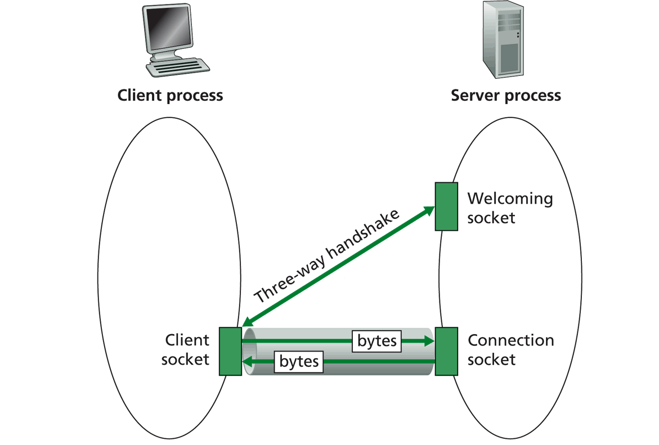
Recap: TCP Sockets
TCP server socket demux by 4-tuple:
source IP address
source port number
dest IP address
dest port number

Slide 5
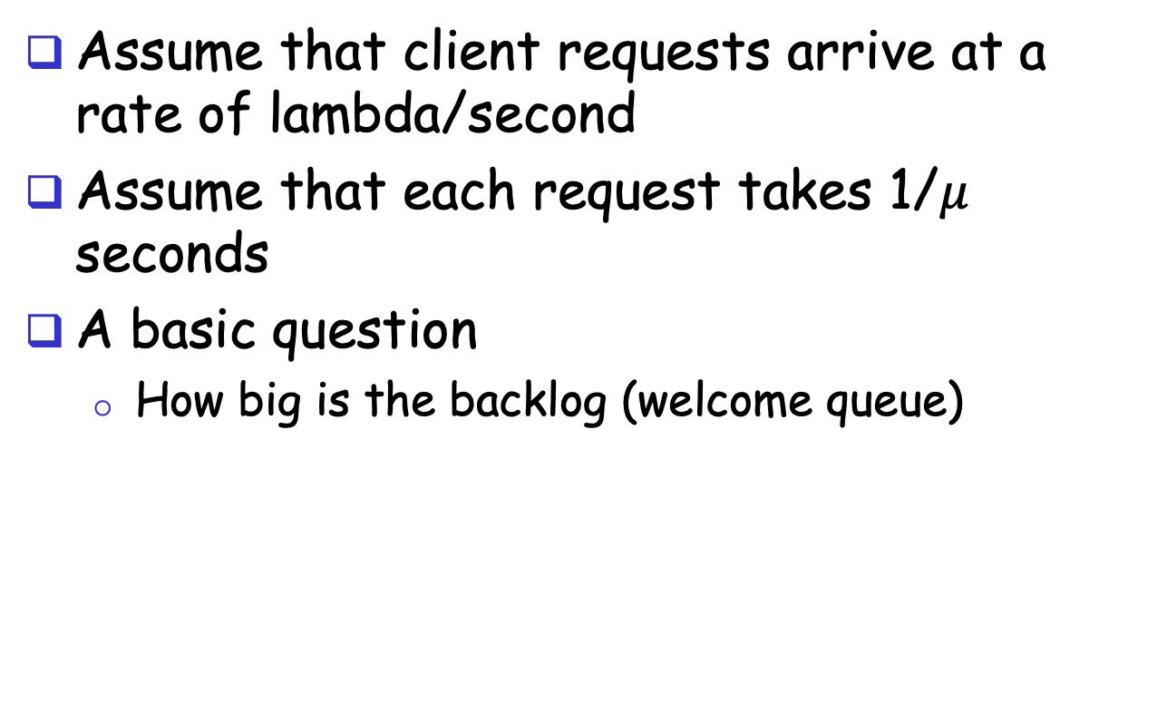
Analysis
Assume that client requests arrive at a rate of lambda/second
Assume that each request takes 1/$μ$ seconds
A basic question
How big is the backlog (welcome queue)
Welcome Socket Queue

Slide 6
Analysis
Is there any interop issue in the sample program?

Slide 7
Analysis
Is there any interop issue in the sample program?
DataOutputStream writeBytes(String) truncates
http://docs.oracle.com/javase/1.4.2/docs/api/java/io/DataOutputStream.html#writeBytes(java.lang.String)

Slide 8
Summary: Basic Socket Programming
They are relatively straightforward
UDP: DatagramSocket
TCP: ServerSocket, Socket
The main function of socket is multiplexing/demultiplexing to application processes
UDP uses (dst IP, port)
TCP uses (src IP, src port, dst IP, dst port)
Always pay attention to encoding/decoding

Slide 9
Outline
Admin. and recap
Network application programming
UDP sockets
TCP sockets
Network applications (continue)
File transfer (FTP) and extension

Slide 10

FTP: the File Transfer Protocol
FTP
user
interface
FTP
client
file transfer
FTP
server
user
at host
local file
system
remote file
system
Transfer files to/from remote host
Client/server model
client: side that initiates transfer (either to/from remote)
server: remote host
ftp: RFC 959
ftp server: port 21/20 (smtp 25, http 80)

Slide 11
FTP Commands, Responses
Sample commands:
sent as ASCII text over control channel
USER username
PASS password
PWD returns current dir
STAT shows server status
LIST returns list of file in current directory
RETR filename retrieves (gets) file
STOR filename stores file
Sample return codes
status code and phrase
331 Username OK, password required
125 data connection already open; transfer starting
425 Can’t open data connection
452 Error writing file
Notes:
PORT h1,h2,h3,h4,p1,p2 specifies the IP address and port the client receives its data

Slide 12
FTP Protocol Design
FTP
client
FTP
server
What is the simplest design of data transfer?
TCP control connection
port 21 at server
RETR file.dat
data

Slide 13
FTP: A Client-Server Application with Separate Control, Data Connections
Two types of TCP connections opened:
A control connection: exchange commands, responses between client, server.
“out of band control”
Data connections: each for file data to/from server
Discussion: why does FTP separate control/data connections?
Q: How to create a new data connection?
Notes:
A: someone (either server or client) needs to pick a new port

Slide 14
Traditional FTP: Client Specifies Port for Data Connection
FTP
client
FTP
server
TCP control connection
port 21 at server
PORT clientip:cport
RETR file.dat
Server initiates TCP data connection
server:20 clientip:cport

Slide 15
Example using telnet/nc
Use telnet for the control channel
telnet ftp.ietf.org 21
user anonymous
pass your_email
port 10,90,61,172,4,1
list
use nc (NetCat) to receive/send data with server
nc –v –l 1025
client
IP address
port
number

Slide 16
Problem of the Client PORT Approach
Many Internet hosts are behind NAT/firewalls that block connections initiated from outside
FTP
client
FTP
server
TCP control connection
port 21 at server
PORT clientip:cport
RETR file.dat
Server initiates TCP data connection
server:20 clientip:cport

Slide 17
FTP PASV: Server Specifies Data Port, Client Initiates Connection
FTP
client
FTP
server
FTP
client
FTP
server
TCP control connection
port 21 at server
TCP control connection
port 21 at server
PORT clientip:cport
PASV
serverip:sport
RETR file.dat
RETR file.dat
Server initiates TCP data connection
server:20 clientip:cport
Client initiates TCP data connection
of PASV returned serverip:sport

Slide 18
Example
Use Wireshark to capture FTP traffic
Using chrome to visit ftp://ftp.freebsd.org

Slide 19
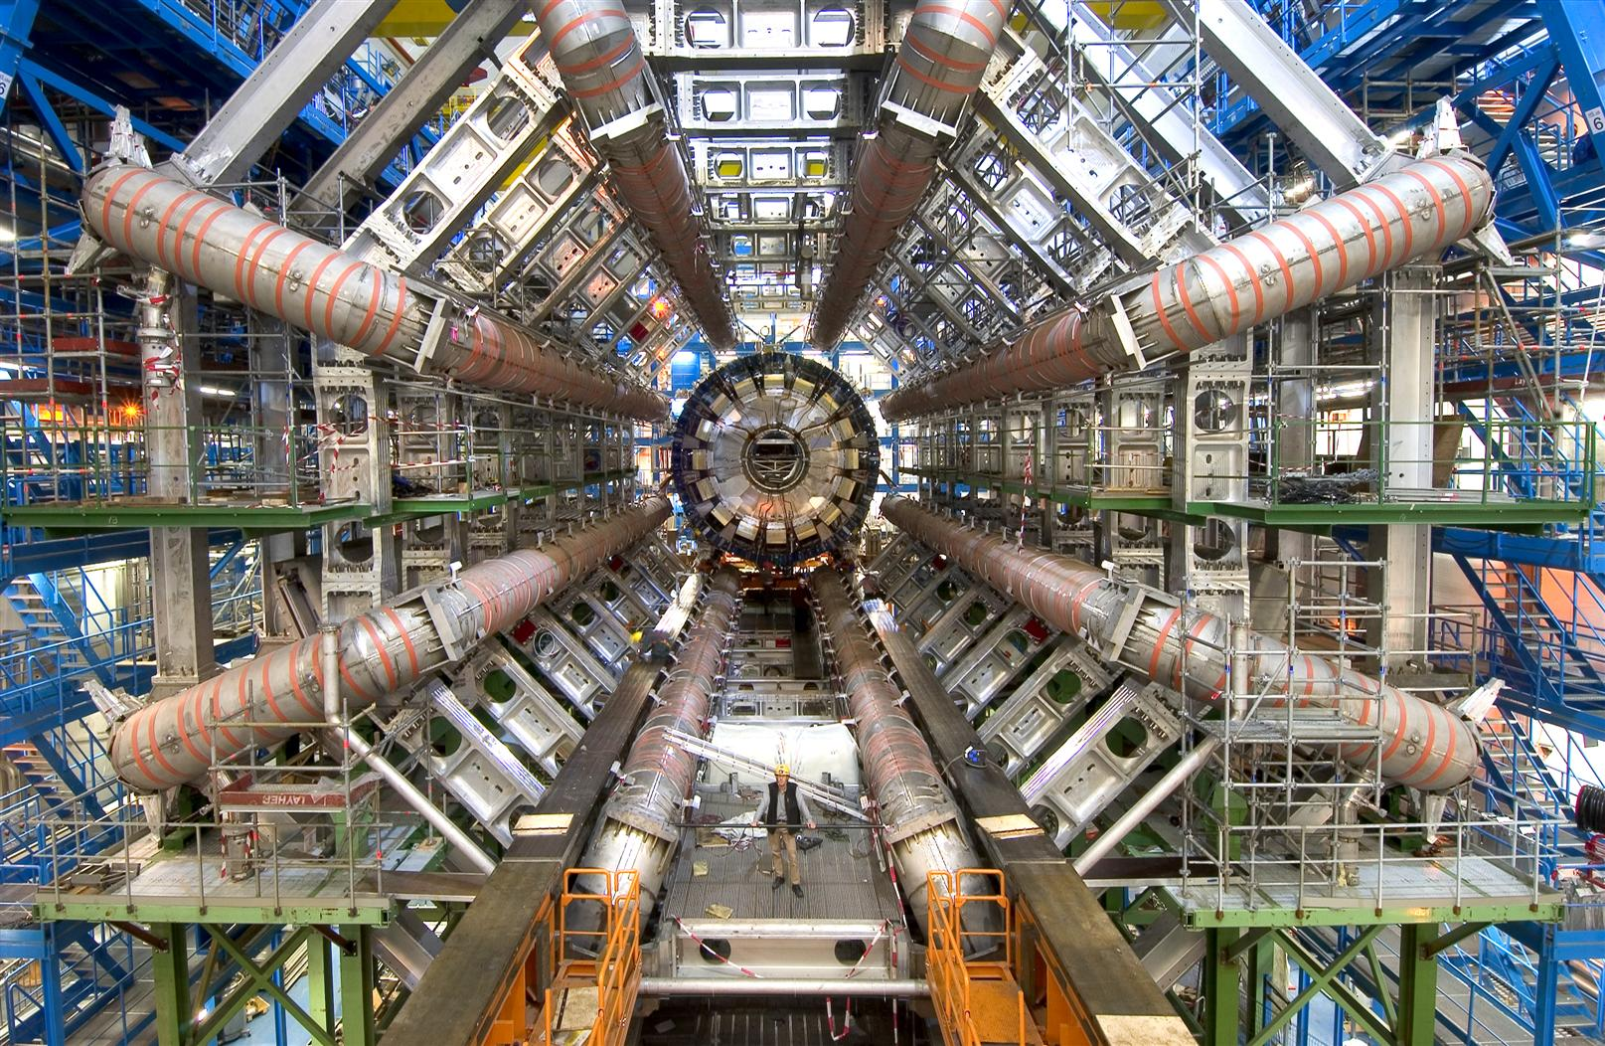
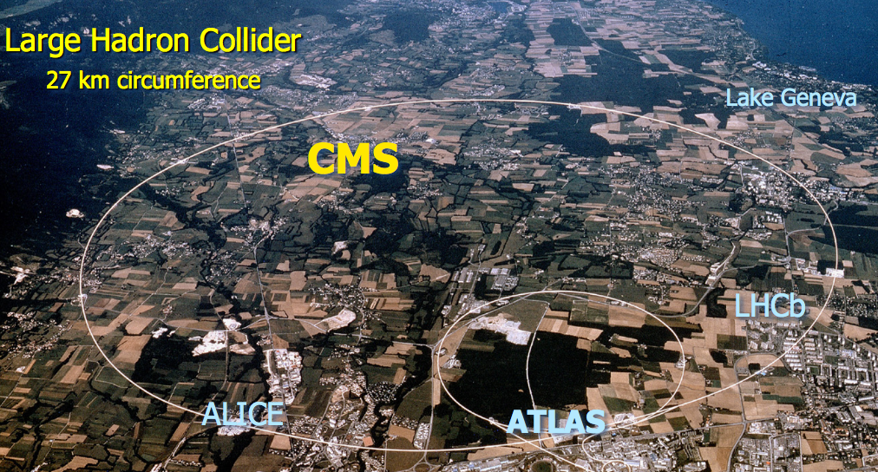
FTP Extensions
FTP with extensions are being used extensively in large data set transfers (e.g., LHC)

Slide 20
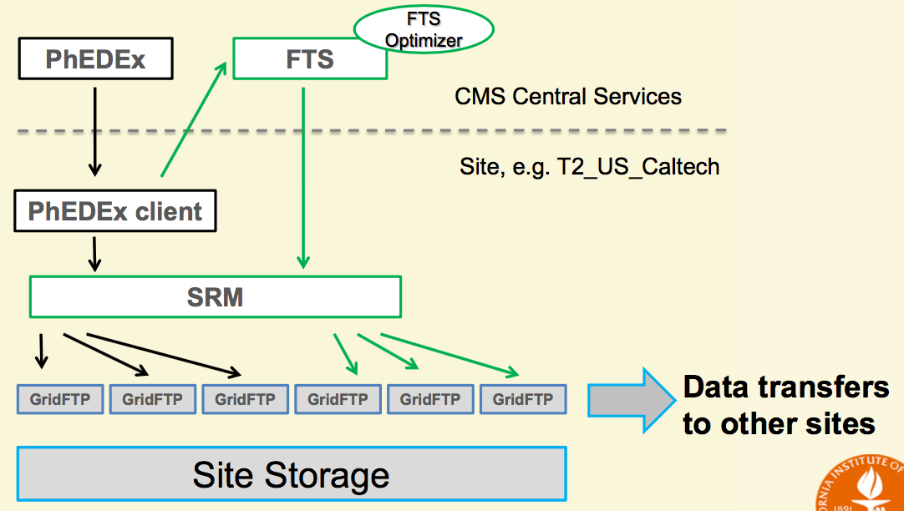
Data Transfer Structure
See GridFTP to FTP extensions
https://www.ogf.org/documents/GFD.20.pd
Goal of GridFTP: allow parallel, high-throughput data transfer
Discussion: What features do we need to add to FTP to allow parallel transfers?

Slide 21
FTP Evaluation
application
transport
network
data link
physical
request
Key questions to ask about a C-S application
- Is the application extensible?
- Is the application scalable?
- How does the application handle server failures (being robust)?
- How does the application provide security?
reply
application
transport
network
data link
physical
What are some interesting design features of the FTP protocol?

Slide 22
Outline
Admin. and recap
Network application programming
UDP sockets
TCP sockets
Network applications (continue)
File transfer (FTP) and extension
HTTP

Slide 23
From Opaque Files to Web Pages
Web page:
authored in HTML
addressed by a URL
URL has two components:
host name, port number and
path name
Most Web pages consist of:
base HTML page, and
several referenced objects
E.g., image
http request
User agent: Explorer
http response
http://qiaoxiang.me:80/index.html
http request
Server
running
Apache Web
server
http response
User agent:
Firefox
The Web pages are requested through HTTP: hypertext transfer protocol

Slide 24
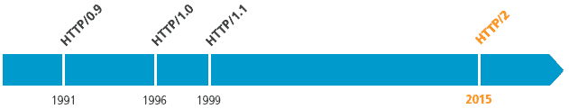
HTTP is Still Evolving
RFC 1945
RFC 2068
RFC 7540

Slide 25
HTTP 1.0 Message Flow
Server waits for requests from clients
Client initiates TCP connection (creates socket) to server, port 80
Client sends request for a document
Web server sends back the document
TCP connection closed
Client parses the document to find embedded objects (images)
repeat above for each image

Slide 26
HTTP 1.0 Message Flow (more detail)
0. http server at host qiaoxiang.me waiting for TCP connection at port 80.
Suppose user enters URL qiaoxiang.me/index.html
1a. http client initiates TCP connection to http server (process) at qiaoxiang.me. Port 80 is default for http server.
1b. server “accepts” connection, ack. client
2. http client sends http request message (containing URL) into TCP connection socket
3. http server receives request message, forms response message containing requested object (index.html), sends message into socket (the sending speed increases slowly, which is called slow-start)
time

Slide 27
HTTP 1.0 Message Flow (cont.)
4. http server closes TCP connection.
5. http client receives response message containing html file, parses html file, finds embedded image
time
6. Steps 1-5 repeated for each of the embedded images

Slide 28
Discussion
How about we use FTP as HTTP?
FTP
client
FTP
server
FTP
client
FTP
server
TCP control connection
port 21 at server
TCP control connection
port 21 at server
PORT clientip:cport
PASV
serverip:sport
RETR index.html
RETR index.html
Server initiates TCP data connection
server:20 clientip:cport
Client initiates TCP data connection
of PASV returned serverip:sport
Notes:
Content negotiation, content type indication

Slide 29
HTTP1.0 Message Flow
HTTP1.0 servers are stateless servers: each request is self-contained
FTP
client
FTP
server
HTTP
client
HTTP
server
USER xxx
PASS xxx
CWD home
PORT clientip:cport
GET /home/index.html USER: xxx PASS: xxx
RETR index.html
Server initiates TCP data connection
server:20 clientip:cport
Server sends file on same connection

Slide 30
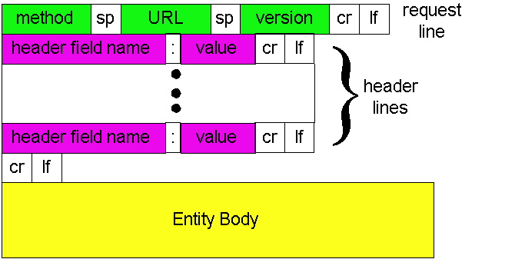
HTTP Request Message: General Format
ASCII (human-readable format)

Slide 31
Trying out HTTP (client side) for yourself
1. Telnet to your favorite Web server:
telnet qiaoxiang.me 80
Opens TCP connection to port 80
(default http server port) at qiaoxiang.me.
Anything typed in sent
to port 80 at qiaoxiang.me
2. Type in a GET http request:
GET /index.html HTTP/1.0
By typing this in (hit carriage
return twice), you send
this minimal (but complete)
GET request to http server
3. Look at response message sent by the http server.

Slide 32
Trying out HTTP (client side) for yourself
Try telnet GET on www.xmu.edu.cn

Slide 33
HTTP Request Message Example: GET
Virtual host multiplexing
request line
(GET, POST,
HEAD, PUT, DELETE, TRACE … commands)
GET /somedir/page.html HTTP/1.0 Host: www.somechool.edu Connection: close
User-agent: Mozilla/4.0
Accept: text/html, image/gif, image/jpeg
Accept-language: en
(extra carriage return, line feed)
Connection management
header
lines
Carriage return,
line feed
indicates end
of message
Content negotiation

Slide 34
HTTP Response Message
status line
(protocol
status code
status phrase)
HTTP/1.0 200 OK
Date: Wed, 23 Jan 2008 12:00:15 GMT
Server: Apache/1.3.0 (Unix)
Last-Modified: Mon, 22 Jun 1998 …...
Content-Length: 6821
Content-Type: text/html
data data data data data ...
header
lines
data, e.g.,
requested
html file

Slide 35
HTTP Response Status Codes
In the first line of the server->client response message. A few sample codes:
200 OK
request succeeded, requested object later in this message
301 Moved Permanently
requested object moved, new location specified later in this message (Location:)
400 Bad Request
request message not understood by server
404 Not Found
requested document not found on this server
505 HTTP Version Not Supported

Slide 36
Trying Use Chrome to visit Course Page

Slide 37
Design Exercise
Workflow of an HTTP server processing a GET request that maps to a file: GET /somedir/page.html HTTP/1.0 Host: www.somechool.edu

Slide 38
Basic HTTP Server Workflow
Create ServerSocket(6789)
128.36.232.5 128.36.230.2
TCP socket space
state: listening
address: {*.6789, *.*}
completed connection queue: sendbuf:
recvbuf:
connSocket = accept()
read request from connSocket
state: established
address: {128.36.232.5:6789, 198.69.10.10.1500}
sendbuf:
recvbuf:
Map URL to file
state: listening
address: {*.25, *.*}
completed connection queue:
sendbuf:
recvbuf:
Read from file/ write to connSocket
close connSocket

Slide 39
Example Code
See BasicWebServer.java
Try using telnet and real browser, and fetch
file1.html
index.html
what difference in behavior?

Slide 40
Static -> Dynamic Content
Create ServerSocket(6789)
connSocket = accept()
It does not have to be a static file
read request from connSocket
Map URL to file
Read from file/ write to connSocket
close connSocket

Slide 41
Dynamic Content Pages
There are multiple approaches to make dynamic web pages:
Embed code into pages (server side include)
http server includes an interpreter for the type of pages
Invoke external programs (http server is agnostic to the external program execution)
E.g., Common Gateway Interface (CGI)
http://www.cs.yale.edu/index.shtml
http://www.cs.yale.edu/cgi-bin/ureserve.pl
http://www.google.com/search?q=Yale&sourceid=chrome

Slide 42
Example SSI
See programming/examples-java-socket/BasicWebServer/ssi/index.shtml, header.shtml, …
Notes:
https://httpd.apache.org/docs/2.2/howto/ssi.html

Slide 43
Example SSI
See programming/examples-java-socket/BasicWebServer/ssi/index.shtml, header.shtml, …
To enable ssi, need configuration to tell the web server (see conf/apache-htaccess)
https://httpd.apache.org/docs/2.2/howto/htaccess.html (Server Side Includes example)
Notes:
https://httpd.apache.org/docs/2.2/howto/ssi.html

Slide 44
CGI: Invoking External Programs
Two issues
Input: Pass HTTP request parameters to the external program
Output: Redirect external program output to socket

Slide 45
Example: Typical CGI Implementation
Starts the executable as a child process
Passes HTTP request as environment variables
http://httpd.apache.org/docs/2.2/env.html
CGI standard: http://www.ietf.org/rfc/rfc3875
Redirects input/output of the child process to the socket

Slide 46
Example: CGI
Example:
GET /search?q=Yale&sourceid=chrome HTTP/1.0
setup environment variables, in particular $QUERY_STRING=q=Yale&sourceid=chrome
start search and redirect its input/output
https://docs.oracle.com/javase/7/docs/api/java/lang/ProcessBuilder.html

Slide 47
Example
https://httpd.apache.org/docs/2.2/howto/htaccess.html (CGI Example)
http://172.28.229.215/BasicWebServer/cgi/price.cgi?appl
#!/usr/bin/perl -w
$company = $ENV{'QUERY_STRING'};
print "Content-Type: text/html\r\n";
print "\r\n";
print "<html>";
print "<h1>Hello! The price is ";
if ($company =~ /appl/) {
my $var_rand = rand();
print 450 + 10 * $var_rand;
} else {
print "150";
}
print "</h1>";
print "</html>";
Notes:
https://httpd.apache.org/docs/2.2/howto/htaccess.html

Slide 48
Client Using Dynamic Pages
See ajax.html and wireshark for client code example
http://172.28.229.215/BasicWebServer/cgi/ajax.html

Slide 49
Discussions
What features are missing in HTTP that we have covered so far?

Slide 50
HTTP: POST
If an HTML page contains forms or parameter too large, they are sent using POST and encoded in message body

Slide 51
HTTP: POST Example
POST /path/script.cgi HTTP/1.0
User-Agent: MyAgent
Content-Type: application/x-www-form-urlencoded
Content-Length: 15
item1=A&item2=B
Example using nc: programming/examples-java-socket/BasicWebServer/nc/

Slide 52
Stateful User-server Interaction: Cookies
client
server
Goal: no explicit application level session
Server sends “cookie” to client in response msg
Set-cookie: 1678453
Client presents cookie in later requests
Cookie: 1678453
Server matches presented-cookie with server-stored info
authentication
remembering user preferences, previous choices
usual http request msg
usual http response +
Set-cookie: #
usual http request msg
Cookie: #
cookie-
specific
action
usual http response msg
usual http request msg
Cookie: #
cookie-
specific
action
usual http response msg

Slide 53
Authentication of Client Request
client
server
Authentication goal: control access to server documents
stateless: client must present authorization in each request
authorization: typically name, password
Authorization: header line in request
if no authorization presented, server refuses access, sends
WWW-authenticate:
header line in response
usual http request msg
401: authorization req.
WWW-authenticate:
usual http request msg
+ Authorization:line
usual http response msg
usual http request msg
+ Authorization:line
usual http response msg
time
Browser caches name & password so
that user does not have to repeatedly enter it.

Slide 54
Example: Amazon S3
Amazon S3 API
http://docs.aws.amazon.com/AmazonS3/latest/API/APIRest.html

Slide 55
HTTP as the Thin Waist
WebMail
WebApp…
HTTP
TCP
UDP
Ethernet
Wireless
Cable/DSL

Slide 56
Protocol Flow of Basic HTTP/1.0
>= 2 RTTs per object:
TCP handshake --- 1 RTT
client request and server responds --- at least 1 RTT (if object can be contained in one packet)
TCP SYN
TCP ACK
TCP/ACK; HTTP GET
base page
TCP SYN
TCP ACK
TCP/ACK; HTTP GET
image 1
Notes:
Typical approaches to reduce latency:
parallel TCP connections
persistent HTTP
cache and conditional GET

Slide 57
Discussion: How to Speedup HTTP/1.0

